Slide 1
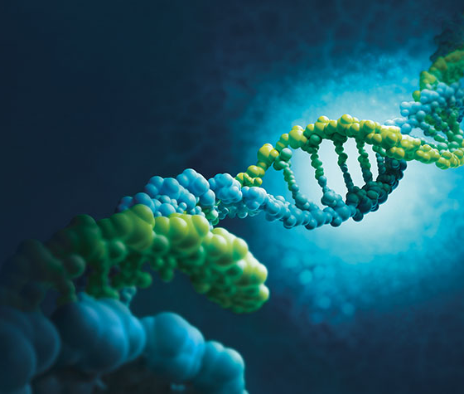
SPA and Friends Hands-On Workshop: Chatting with your Data
MDM 2025
Matthew Kumar
Kevin Dang
Michael Racanelli
June 10, 2025

Slide 2
Today's Schedule:
Overview
🚀 Intro + Overview 🕛 1:00pm – 1:10pm
👨‍💻 Hands-On Activity 🕧 1:15pm – 3:00pm
🎉 Open Discussion 🕐 3:00pm – 3:30pm
🔂 Wrap Up (Overflow) 🕐 3:55pm – 4:00pm

Slide 3
Preamble:
Building AI Experience for the Future
🚀 AI is Transforming….. Everything
🗣 Most are familiar with conversational AI (e.g., www.chatgpt.com) for routine tasks
🎯 Ability to enhance productivity and efficiency in our actual day to day tasks
🚧 Understand their limitations, risks and fit
🔧 Like any new tool, we must invest time to develop proficiency
💪 Build experience and intuition through hands-on experimentation - Today!
🧠 Apply and Extend Your Learnings – Near Future!
🌟 Embrace New Ways of Working - Future!

Slide 4
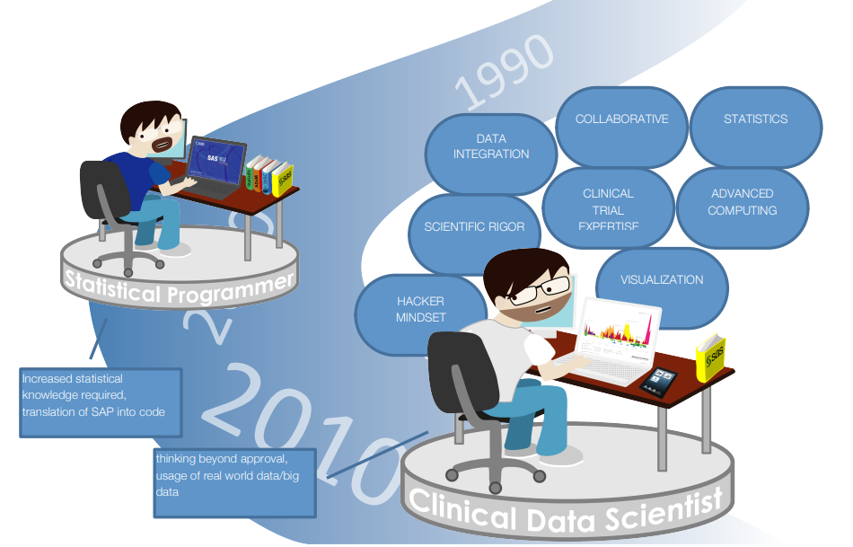
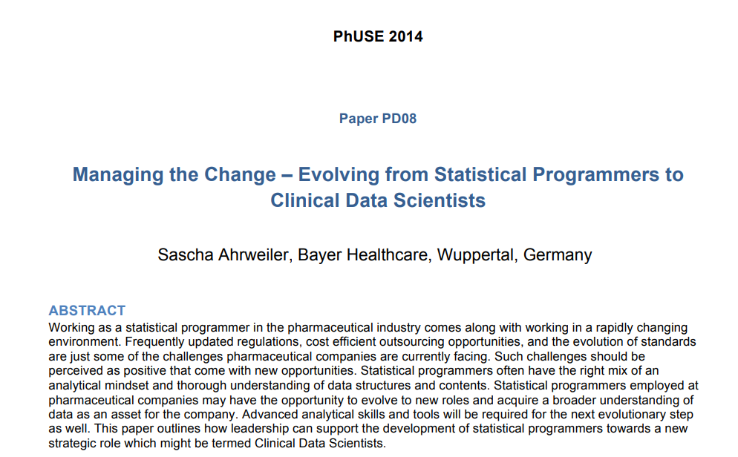
Overview:
Stage Setting
Link to Paper

Slide 5

Overview:
The Next Evolution?

Slide 6
Today's Mission 🎯
Roll up your sleeves
👨🏼‍🔬 A “sandbox” application for you to experiment with AI has been setup!
💬 It will allow you to chat naturally and interact with a few clinical trial data themes
- Patient Exploration: ADSL
- Safety: ADAE
- Efficacy: ADTTE, ADRS
📊 Real data exploration and insights without the complexity

Slide 7
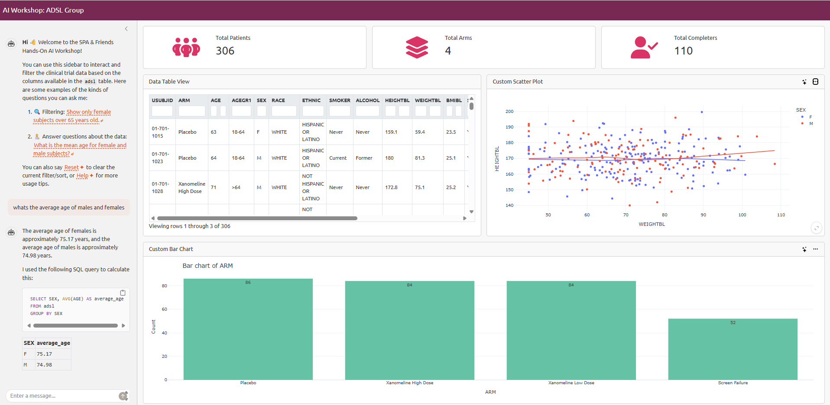
Sandbox App
Chat Interface (sidebar)
An Interactive Data Table (filterable)
A few interactive visualizations
2
3
1

Slide 8
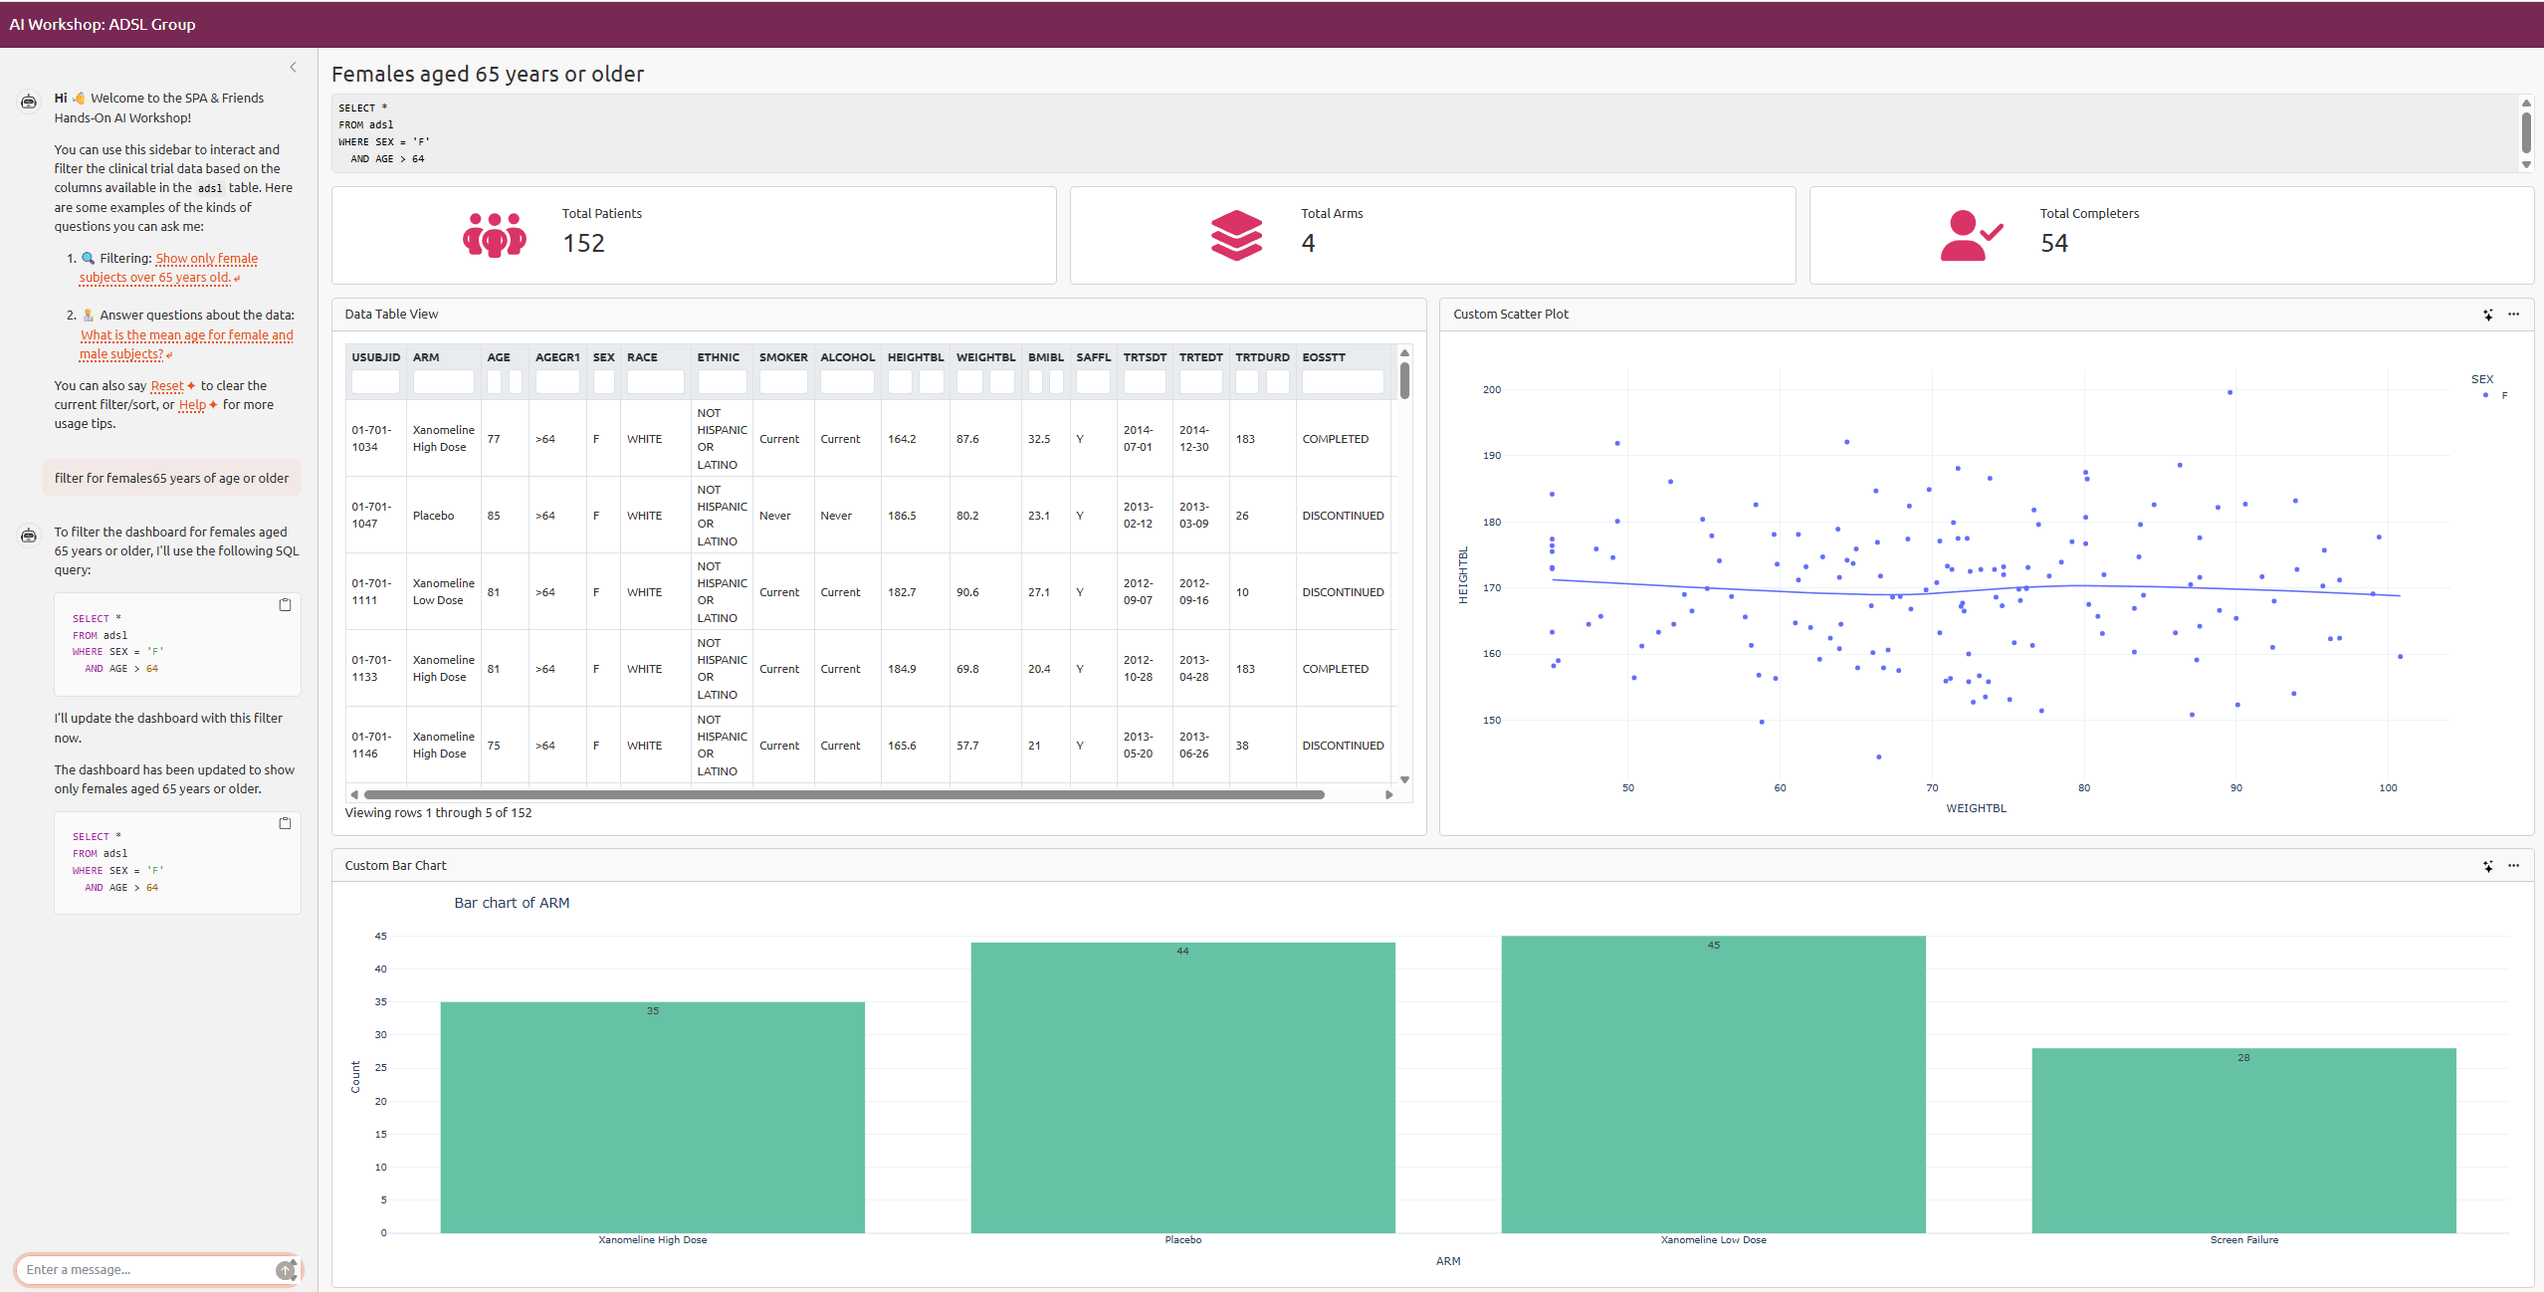
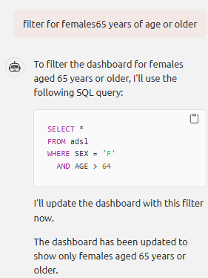
Sandbox App Filtering
All dashboard elements updated!

Slide 9
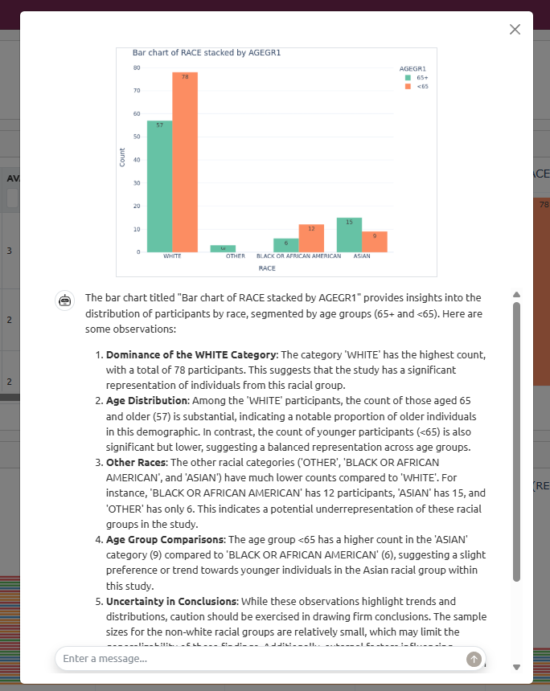
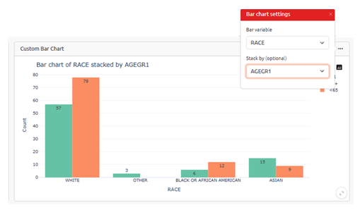




Sandbox App Visualizations
Visualization (Configurable)
Image Interpretation

Slide 10
Exercise: Open Format Exploration
🔍 Investigate - Get comfortable with AI chat interfaces, build intuition and experience
🕳️ Dig Deeper - Ask basic questions, build up to complex ones, find insights, use domain expertise!
🎯 Apply - Use insights to understand and solve real problems
Be prepared to share at least one experience related to these themes in the open discussion:
What worked well: What did you find? What surprised you? Find something cool? Examples
What didn’t work so well: Where did AI have an issue? Or the app? Examples
Future-focused: How do you envision AI transforming parts of your current tasks? Examples

Slide 11
App Links 🌍
🔗ADSL: go/mdm-adsl
🔗ADAE: go/mdm-adae
🔗ADTTE: go/mdm-adtte
🔗ADRS: go/mdm-adrs
- 🧪 Experiment boldly - there's no wrong way to explore
- 🤝 Ask for help - we're here to support you
- 🎯 Focus on the journey - how you get answers matters

Slide 12


How Was It?

Slide 13
Open Discussion 🗣
What worked well: What did you find? What surprised you? Find something cool? Examples
Use Flipcharts in Room and take pictures for these slides

Slide 14
Open Discussion 🗣
What didn’t work so well: Where did AI have an issue? Or the app? Examples
Use Flipcharts in Room and take pictures for these slides

Slide 15
Open Discussion 🗣
Future-focused: How do you envision AI transforming parts of your current tasks? Examples
Use Flipcharts in Room and take pictures for these slides

Slide 16
Thank You!
MDM 2025
June 10, 2025

